Slide 1
A PRIMER IN COLUMN GENERATION
Hongming Li
College of Management and Economics
Tianjin University
Workshop on Mixed-Integer Programming, Spring 2018

Slide 2
Question
What is the difference between column generation and benders decomposition?
What is column generation?
What are the advantages and disadvantages?

Slide 3
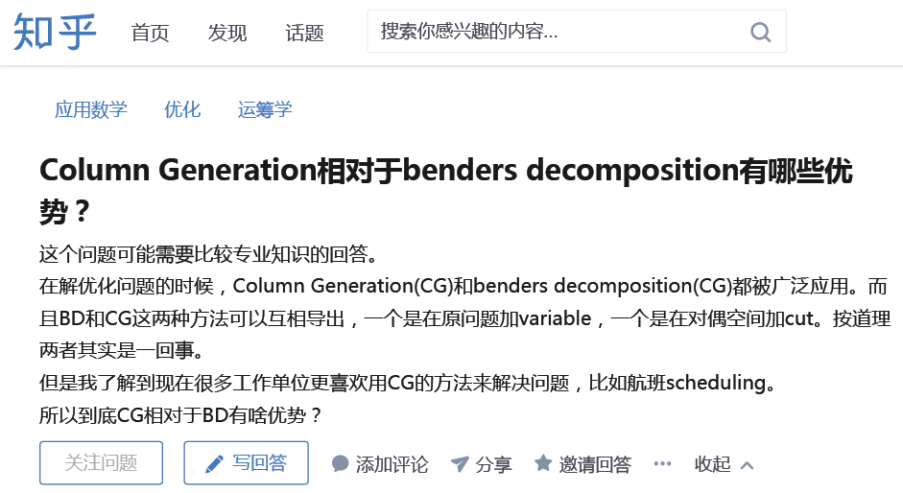
A question in Zhihu

Slide 4
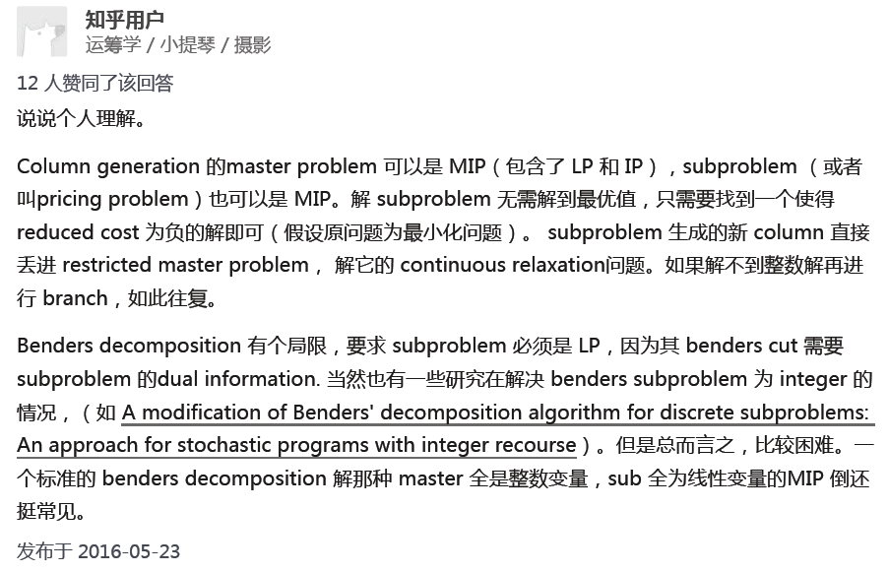
Answer 1

Slide 5
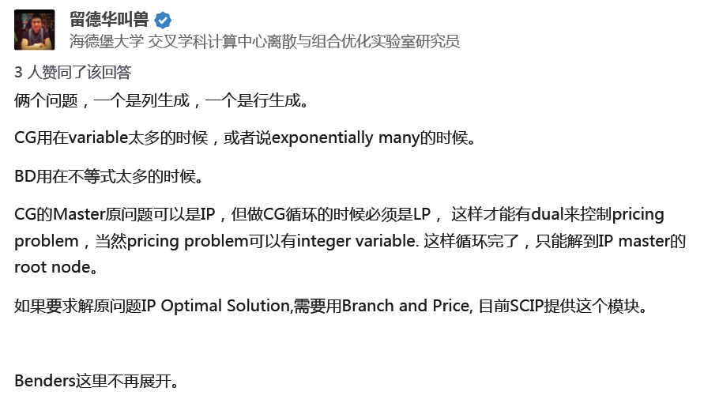
Answer 2

Slide 6
Column generation
Column generation or delayed column generation is an efficient algorithm for solving larger linear programs.
The overarching idea is that many linear programs are too large to consider all the variables explicitly.

Slide 7
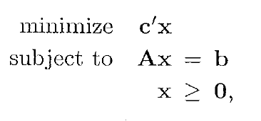
Column generation
Consider the following problem:

Slide 8
Column generation
Since most of the variables will be non-basic and assume a value of zero in the optimal solution, only a subset of variables need to be considered in theory when solving the problem.
Column generation leverages this idea to generate only the variables which have the potential to improve the objective function→ to find variables with negative reduced cost.

Slide 9
Column generation
The problem being solved is split into two problems:
The restricted master problem
The subproblem

Slide 10
Column generation
The restricted master problem (RMP) is the original problem with only a subset of variables being considered.
The subproblem (SP) is a new problem created to identify a new variable.
The objective function of the subproblem is the reduced cost of the new variable with respect to the current dual variables, and the constraints require that the variable obey the naturally occurring constraints.

Slide 11
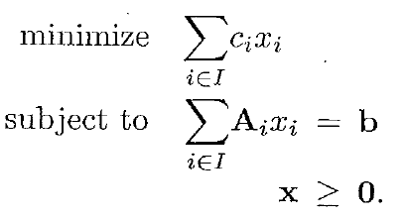
Column generation
Restricted master problem (RMP):

Slide 12

Column generation
Subproblem (SP):

Slide 13
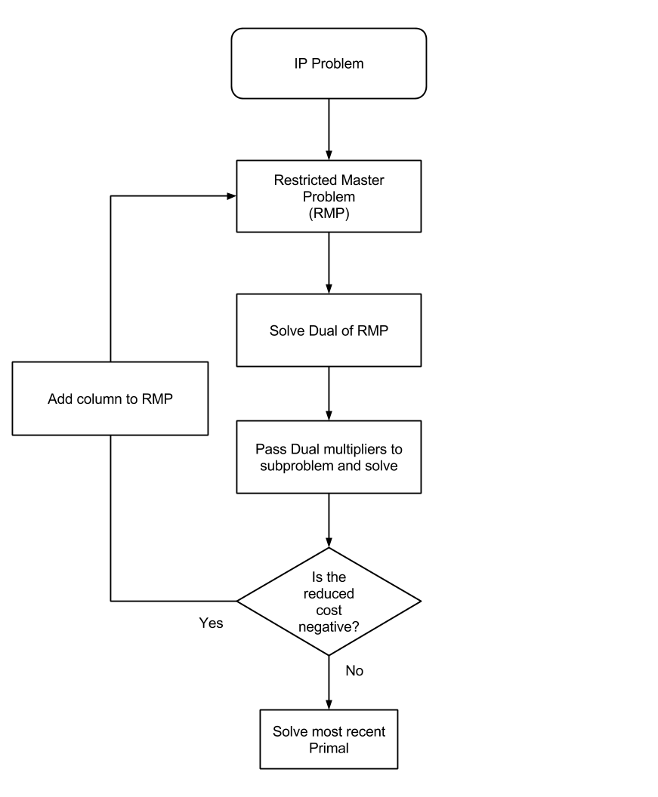
Column generation

Slide 14
Hands-On Experience

Slide 15
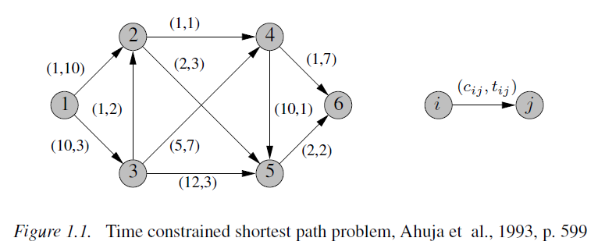
Time constrained shortest path problem

Slide 16
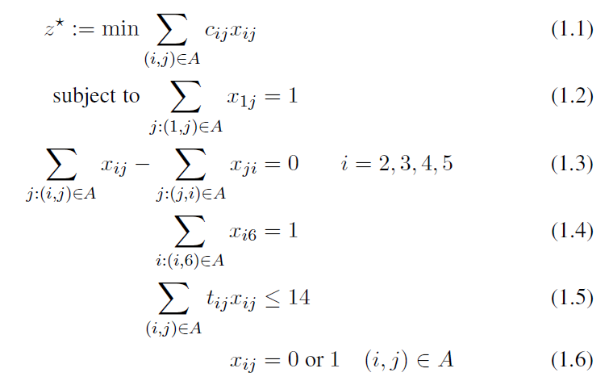
Integer program

Slide 17
Integer program
In fact, no polynomial time algorithm is likely to exist since the resource constrained shortest path problem is NP-hard.
However, since the problem is almost a shortest path problem, we would like to exploit this embedded well-studied structure algorithmically.

Slide 18



An Equivalent Reformulation: Arcs vs. Paths
If we ignore the complicating constraint (1.5), then
An extreme point of the polytope defined by the convex hull of X corresponds to a path in the network.

Slide 19
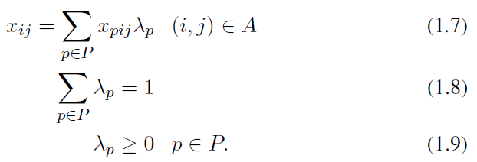
An Equivalent Reformulation: Arcs vs. Paths
This enables us to express any arc flow as a convex combination of path flows:

Slide 20
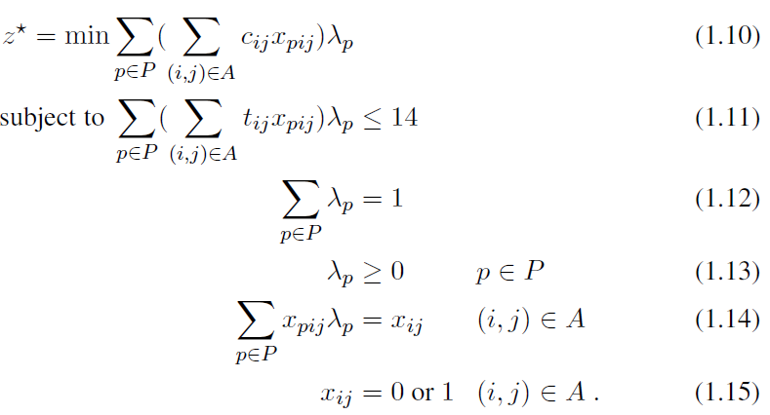
An Equivalent Reformulation: Arcs vs. Paths
If we substitute for X in (1.1) and (1.5) we obtain the so-called master problem:

Slide 21

The Linear Relaxation of the Master Problem
One starts with solving the linear programming (LP) relaxation of the master problem. There remains a problem with nine path variables and two constraints

Slide 22
The Linear Relaxation of the Master Problem
For large networks, the cardinality of P becomes prohibitive, and we cannot even explicitly state all the variables of the master problem.
The appealing idea of column generation is to work only with a sufficiently meaningful subset of variables, forming the so-called restricted master problem (RMP).

Slide 23

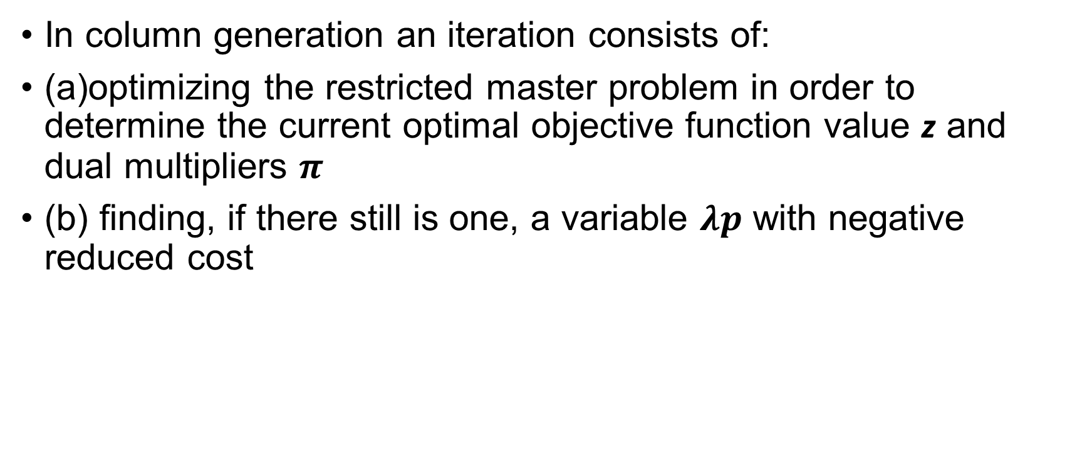
The Linear Relaxation of the Master Problem
In column generation an iteration consists of:
(a)optimizing the restricted master problem in order to determine the current optimal objective function value z and dual multipliers $π$
(b) finding, if there still is one, a variable $λp$ with negative reduced cost

Slide 24

The Linear Relaxation of the Master Problem
The implicit search for a minimum reduced cost variable amounts to optimizing a subproblem

Slide 25
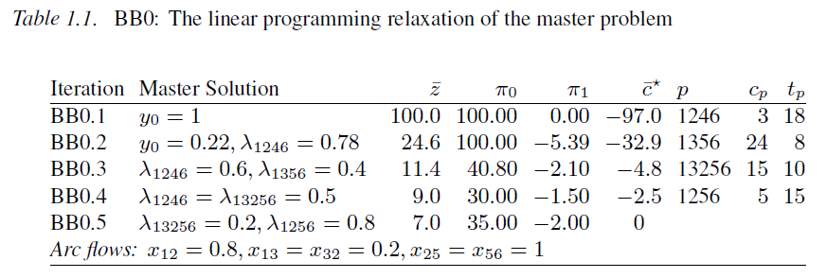
The Linear Relaxation of the Master Problem
We now give full numerical details of the solution of our particular instance.

Slide 26
Advantages and Disadvantages
Saving time and memory is where column generation algorithms shine.
The initial formulation of MILPs using column generation algorithms may be difficult to see at first.
if a formulation can be arrived at, use of a column generation algorithm has many potential time savings.

